Slide 1

Connecting Local Farmers with Consumers: The Future of Fresh Produce Delivery
Connecting local farmers with consumers is revolutionizing the way we access fresh food. This presentation explores the rise of farm-to-fork e-commerce platforms and their impact on communities, the environment, and the future of food delivery.

Slide 2
The Rise of Farm-to-Fork E-Commerce Platforms
Growing Demand
Convenience
Consumers increasingly seek fresh, locally-sourced produce, driving the growth of online farm-to-table marketplaces.
Platforms offer convenient access to a wide variety of produce, delivered directly to customers' doorsteps.

Slide 3

Benefits of Buying Local: Supporting the Community and the Environment
Economic Empowerment
Environmental Sustainability
Local farmers receive fair prices and increased revenue, boosting local economies.
Reducing transportation distances lowers carbon emissions and supports sustainable agriculture practices.

Slide 4

How Platforms Streamline the Farmer-to-Consumer Supply Chain
1
Order Placement
Consumers browse and order produce directly from participating farms through the platform.
2
Order Fulfillment
Farmers receive orders and prepare produce for delivery, often within a designated timeframe.
3
Delivery
Platforms facilitate deliveries through partnerships with delivery services or by farmers themselves.

Slide 5




Leveraging Technology to Increase Accessibility and Transparency
Geolocation
Product Details
Secure Payments
Platforms showcase nearby farms, allowing consumers to discover local options.
Detailed information on origins, growing practices, and seasonal availability promotes transparency.
Platforms facilitate secure online payments, enhancing user experience and convenience.

Slide 6




Empowering Farmers: Expanded Reach and Fair Pricing
1
Increased Market Access
2
Reduced Overhead Costs
3
Direct Consumer Relationships
4
Fairer Pricing

Slide 7
Meeting Consumer Demand for Fresher, Healthier Produce
1
Seasonality & Freshness
2
Variety & Choice
3
Sustainable Practices

Slide 8
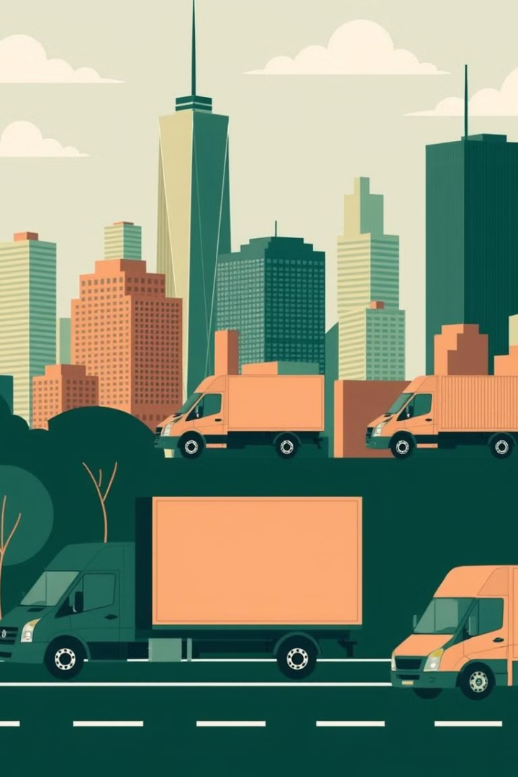
The Future of Local Food Delivery: Trends and Opportunities
100M
10
Market Growth
Personalized Experiences
The global farm-to-table market is projected to reach $100 million by 2027.
Platforms are incorporating personalization features to tailor offerings to individual needs.
50%
Sustainability Focus
Increased emphasis on sustainable practices and environmental responsibility.

